Slide 1
CMP_SC 3380 Final project Group 18
Reconstruction of the Student Unions website.

Slide 2
Overview
Cascade Server
No SSL Available
Replacement CMS
Unions Admin Portal
Lost & Found Module
User Management

Slide 3
Technologies
Languages Used: PHP 5.5.6, jQuery, jQuery UI, Twitter Bootstrap, SOAP/XML
Databases: PostgreSQL and SQL Server
Version Control: GIT on Github
Framework: Yii 1.1 (MVC)
Web Server: Apache
Tools: PhpStorm, SourceTree, pgAdmin3

Slide 4
Datasets Utilized
EMS (Event Management System) API
Event Spaces & Meeting Times
SQL Server
Group Name Change
Department Request
PostgresSQL Database
Lost & Found
Policies & Procedures
Event Space Features and Building Attractions

Slide 5
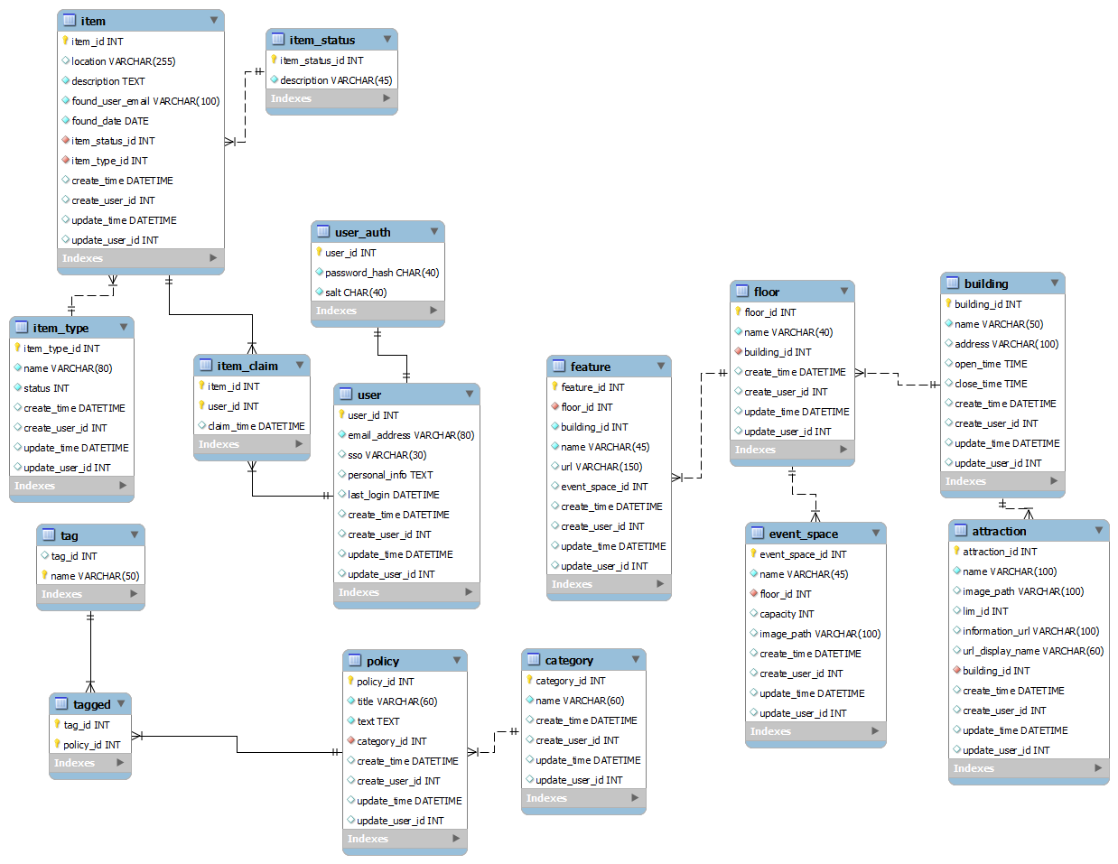

Slide 6
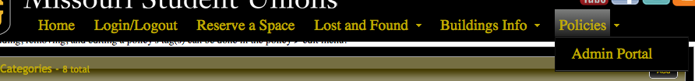
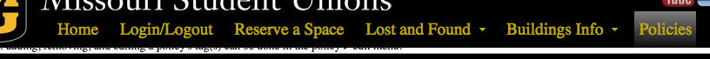
PHP5
JQuery
JQuery UI
Custom JQuery UI Theme
Custom Menu
“Scroll then Sticky”
Animations
Ability to hide
or show based on admin status

Slide 7
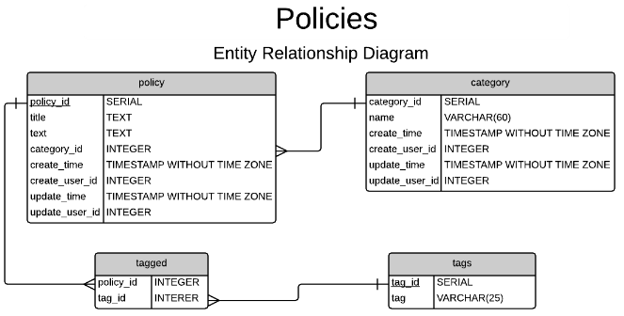

Slide 8
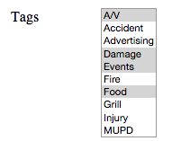
Adding/removing tag(s) from policies.
foreach (item in new_array) {
check if not in old_array
}
foreach (item in old_array) {
check if not in new_array
}
INSERT item INTO tag table
DELETE item FROM tag table
new_array
old_array

Slide 9
Lost and Found Module
Requested by the University
LDAP credential connections
Cross referenced tables for item id and status’
Item types became a challenge
Lost Item Types
Common types (Phone, Laptop, Jacket)
Uncommon (Food, Wife)
Option for new types
Admin Approval
Admin interface

Slide 10
Buildings and Features
2 Buildings, 7 floors, 12 restaurants, and 60 features.
Pull data dynamically from PostgreSQL
Display by building name, floor level
Order Data
SELECT statements and INNER JOINS

Slide 11
Restaurants and Attractions
Load images and all restaurant data from the database
Include links to view information or hours
Make an administrator be able to edit
Restaurant name/Description
Photo Icon
Link to menu

Slide 12
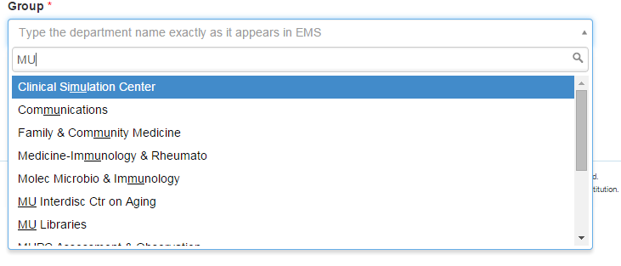
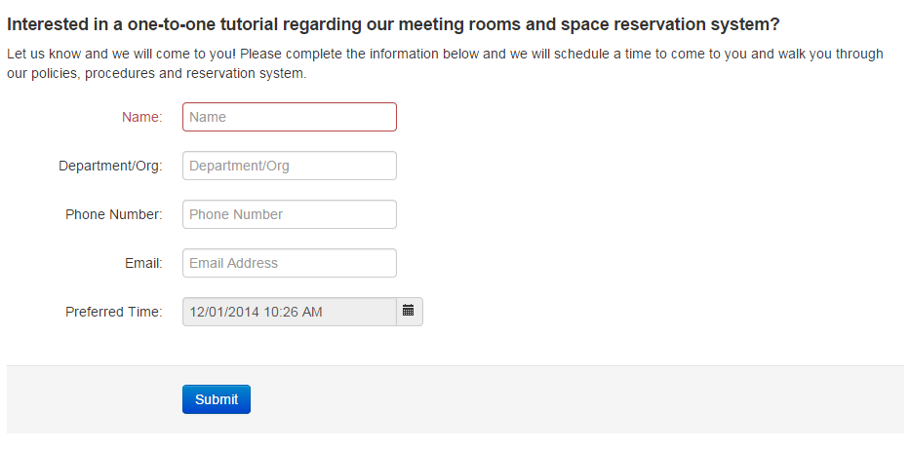
Admin Portal
Group Name Change
Select2 using SQL Server dataset
Approval by Events Manager
Department Request
Approval by Events Manager
Special Areas/Services Request
Entered into EMS as a Web Request

Slide 13
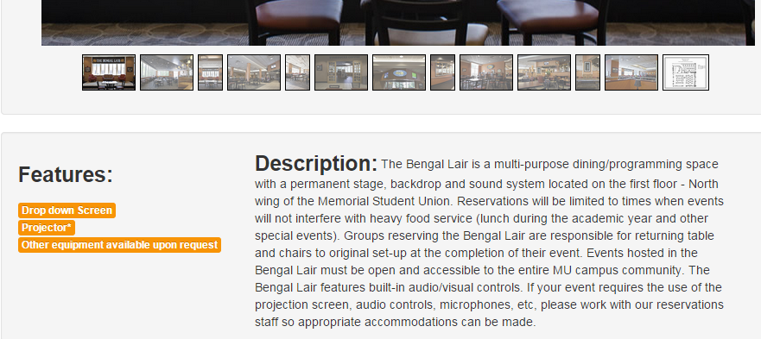
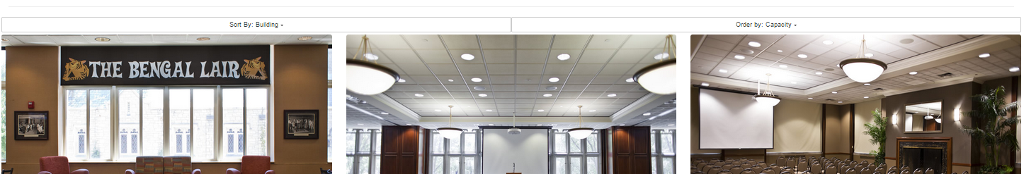
Event Space
Filtering
EMS Integration
EMS API pull the Name, Features, and Description

Slide 14
Reserve a Space
40 different Spaces to reserve
All 40 different Insert Statments
Spaces between Memorial Student Union and Student Center
Includes Capacity to show size of room

Slide 15
Sort Through data
Sort by Building
Sort by Capacity
Still coming is sorting by keyword

Slide 16
Actually Reserving
Links up pages through _POST variables
Sends id’s back and forth between multiple pages
Currently removes space when time is picked
Still working on having a time table to show what is available and not

